Slide 1
A Presentation
By
Chinazom Jennifer Okoli
On
Book Sales Analysis.
4th Sept.,2023

Slide 2
Outline
Introduction
Book Sales Customers Table
To insert new records into Book Sales Customers Table
The Table Image
To Create Table, Orders
To Insert Records inside Table, Orders
Creating Table , Shippers
Findings
Conclusion

Slide 3

Introduction
A Database – SQL Project was created which includes information on Book Sale Customers, Orders and Shippers.
The data collected from the book sales orders were explored and analyzed to gain insights into; Orders made in August 2023, Total Order made per Customer, The Shipper with the Highest Delivery and Country with the highest Order.

Slide 4

By analyzing this data, one can make informed decisions about Marketing Strategies and Inventory Management on the basis of these;
Sales trends by month
Geographic sales analysis
Shipping and delivery analysis
Customer purchasing behavior

Slide 5

Book Sales Customers Table
Syntax;
CREATE TABLE BookSalesCustomers(
CustomerID INT,
CustomerNames varchar(255),
ContactName varchar (255),
Address varchar (255),
PostalCode int,
Country varchar (255)
);
To View Table;
SELECT*FROM [SQL Project]..BookSalesCustomers

Slide 6
To insert records into BookSalesCustomers:
Syntax;
INSERT INTO BookSalesCustomers (CustomerID,CustomerNames,ContactName,Address,PostalCode,Country)
VALUES
(1,'Max Legacy', 'Maxwell Ebuka', '01 Wilson Street', '300001', 'Nigeria') ;
(2,'Kochecks', 'Doris Kosi', '40th 1st Avenue', '900108', 'Nigeria');
(3,'Nyfers Holdings', 'Nazom Jennifer', '32 Umudim','435101','Austria');
(4,'HJJHUB Services','Henry CI','Block 2, Paradise','900180','Turkey'),
(5,'Makkys Touch', 'Amaka Theodora','Street 3, Apo', '900109','United Kingdom'
and so on.....

Slide 7
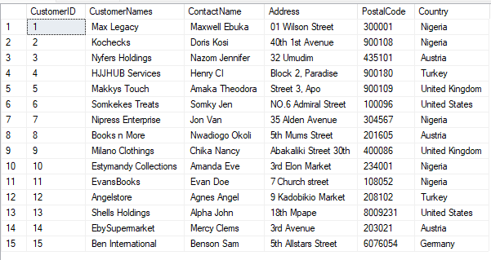

Slide 8
To Create Table, Orders Syntax;
CREATE TABLE Orders(
OrderID int,
CustomerID int,
Quantity int,
OrderDate Date,
ShipperID int
);
TO View Table Orders
SELECT * FROM Orders

Slide 9
To Insert Records inside Table Orders Syntax;
INSERT INTO Orders
VALUES
(1001,2,10,'2023-08-01',1);
(1002,5,2,'2023-08-01',3),
(1003,4,1,'2023-08-02',1),
And so on...
Updating OrderID 1020
UPDATE Orders
SET ORDERID = 1020
WHERE OrderDate= '2023-08-19';

Slide 10
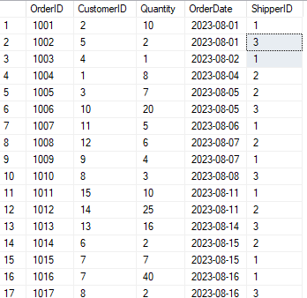
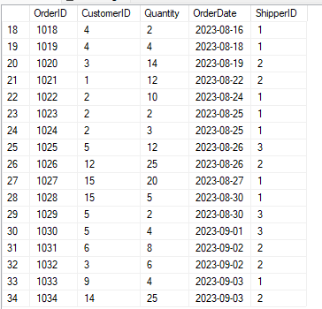

Slide 11
Creating Table , Shippers Syntax;
CREATE TABLE Shippers(
ShipperID int,
ShipperName varchar(255),
Contact int);
Inserting Record for Table Shippers
INSERT INTO Shippers
VALUES
(1, 'DHL',701-529-3314 )
(2, 'FedEx', '(234)817-224-7139');
(3,'UX Express','(234)905-763-1375');
-

Slide 12

To change the Data type of column Contact from int to varchar
ALTER TABLE Shippers
ALTER COLUMN Contact varchar(255)
Updating Contact
UPDATE Shippers
SET Contact = ('(234)701-529-3314')
WHERE ShipperName = 'DHL';

Slide 13

TO Calculate the total Orders placed in August
Findings;
SELECT SUM(Quantity) as TotalOrdersinAugust
FROM Orders
WHERE MONTH(OrderDate) = 8
AND YEAR(OrderDate) = 2023;

Slide 14
To calculate total order made per customer
SELECT CustomerNames, SUM(Quantity) AS Totalpurchases
FROM Orders
JOIN BookSalesCustomers ON Orders.CustomerID = BookSalesCustomers.CustomerID
GROUP BY CustomerNames
ORDER BY SUM(Quantity) DESC
;

Slide 15
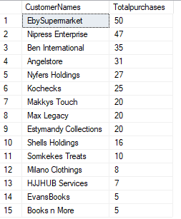

Slide 16
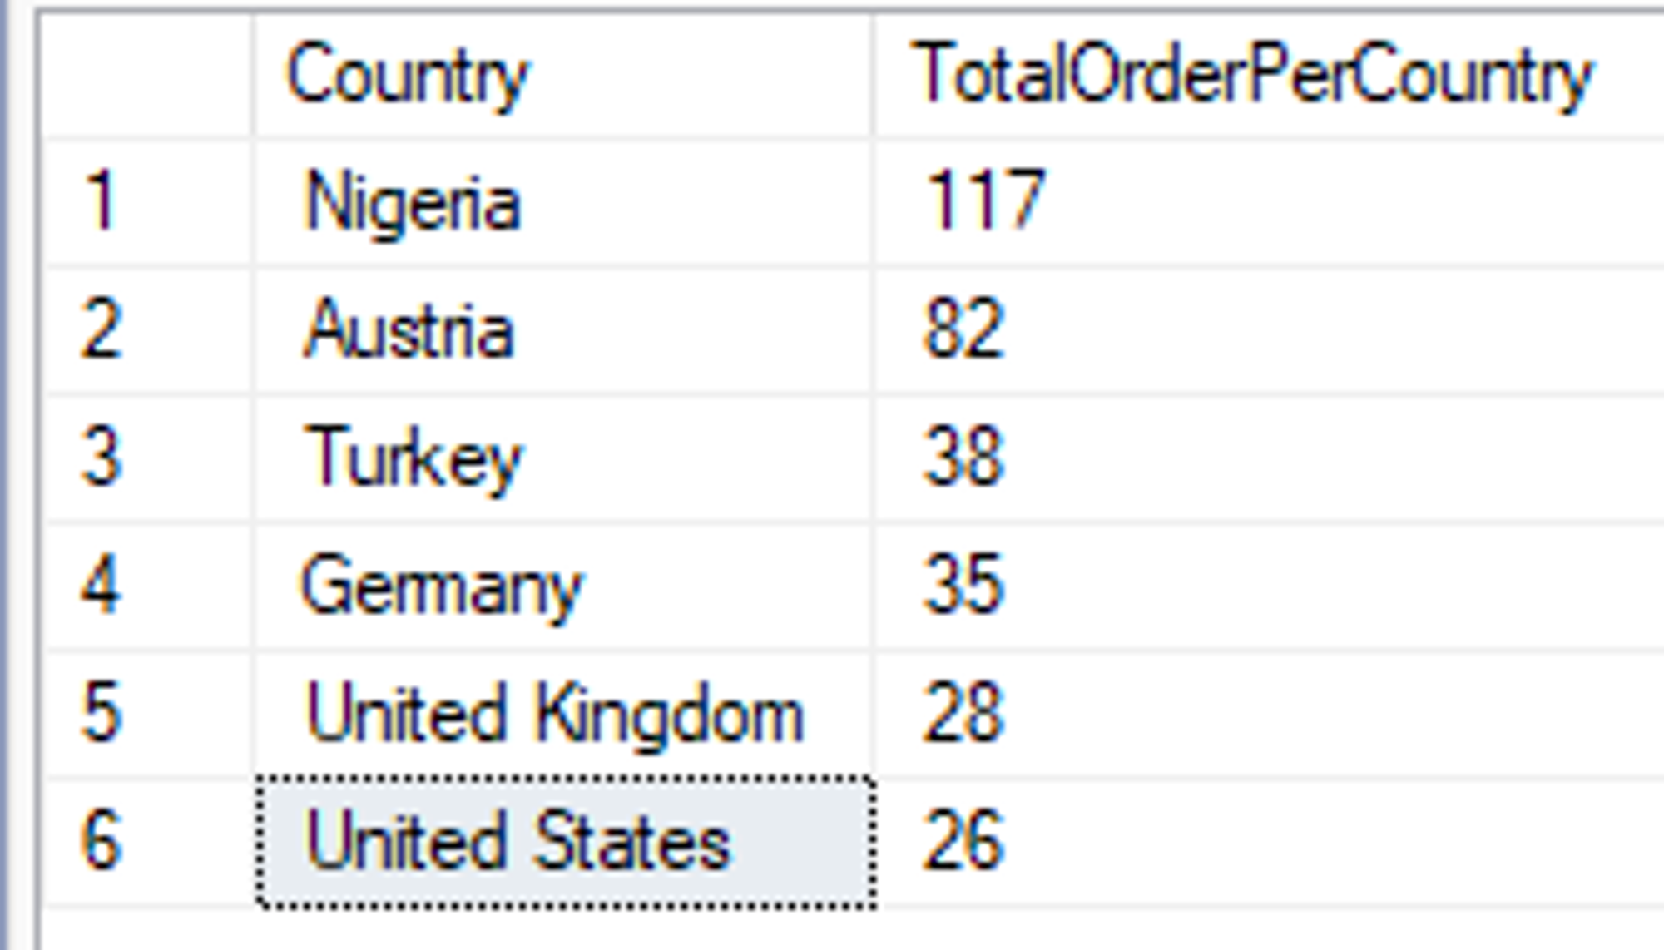
To calculate the total quantity of products purchased per country
SELECT BookSalesCustomers.Country, SUM(Quantity) AS TotalOrderPerCountry
FROM orders
JOIN BookSalesCustomers ON Orders.CustomerID = BookSalesCustomers.CustomerID
GROUP BY BookSalesCustomers.Country
ORDER BY SUM(Quantity) DESC;

Slide 17

Which Shipper made the most Delivery
SELECT ShipperName, SUM(Quantity) As TotalDelivery
FROM Shippers
JOIN Orders ON Shippers.ShipperID = Orders.ShipperID
GROUP BY ShipperName
ORDER BY SUM(Quantity) DESC ;

Slide 18
Conclusion
From the above analysis, we can deduce that;
279 Orders were made in August
Eby Supermarket made 50 purchases which was the highest, followed by Nipress Enterprises with 47 purchases. EvansBooks and Books ‘n’ More made the least with 5 purchases within this period of time.
Products bought per country, Nigeria made the highest purchase with 117 books ordered while United States made the least purchase with 26 books ordered.
FedEx made the most delivery, followed by DHL then UX Express.

Slide 19
THANK
YOU

